Slide 1


Slide 2
Chapter 3
Project Management

Slide 3
OBJECTIVES
Definition of Project Management
Work Breakdown Structure
Project Control Charts
Structuring Projects
Critical Path Scheduling
Notes:
2

Slide 4
Project Management
Defined
Project is a series of related jobs usually directed toward some major output and requiring a significant period of time to perform
Project Management are the management activities of planning, directing, and controlling resources (people, equipment, material) to meet the technical, cost, and time constraints of a project
Notes:
3

Slide 5
Project Control Charts: Gantt Chart
Vertical Axis: Always Activities or Jobs
Horizontal bars used to denote length of time for each activity or job.
Activity 1
Activity 2
Activity 3
Activity 4
Activity 5
Activity 6
Time
Horizontal Axis: Always Time
Notes:
6

Slide 6
Structuring Projects Pure Project: Advantages
Pure Project
Defined
A pure project is where a self-contained team works full-time on the project
The project manager has full authority over the project
Team members report to one boss
Shortened communication lines
Team pride, motivation, and commitment are high
Notes:
8

Slide 7
Structuring Projects Pure Project: Disadvantages
Duplication of resources
Organizational goals and policies are ignored
Lack of technology transfer
Team members have no functional area "home"
Notes:
8

Slide 8
Functional Project
Defined
A functional project is housed within a functional division
President
Research and
Development
Engineering
Manufacturing
Project
A
Project
B
Project
C
Project
D
Project
E
Project
F
Project
G
Project
H
Project
I
Example, Project “B” is in the functional area of Research and Development.
Notes:
9

Slide 9
Structuring Projects
Functional Project: Advantages
A team member can work on several projects
Technical expertise is maintained within the functional area
The functional area is a “home” after the project is completed
Critical mass of specialized knowledge
Notes:
10

Slide 10
Structuring Projects
Functional Project: Disadvantages
Aspects of the project that are not directly related to the functional area get short-changed
Motivation of team members is often weak
Needs of the client are secondary and are responded to slowly
Notes:
11

Slide 11
Structuring Projects:
Matrix Project Organization Structure
President
Research and
Development
Engineering
Manufacturing
Marketing
Manager
Project A
Manager
Project B
Manager
Project C
Notes:
12

Slide 12
Structuring Projects
Matrix: Advantages
Enhanced communications between functional areas
Pinpointed responsibility
Duplication of resources is minimized
Functional “home” for team members
Policies of the parent organization are followed
Notes:
13

Slide 13
Structuring Projects
Matrix: Disadvantages
Too many bosses
Depends on project manager’s negotiating skills
Potential for sub-optimization
Notes:
14

Slide 14
Work Breakdown Structure
Defined
A work breakdown structure defines the hierarchy of project tasks, subtasks, and work packages
Level
Program
1
Project 1
Project 2
2
Task 1.1
Task 1.2
3
Subtask 1.1.1
Subtask 1.1.2
4
Work Package 1.1.1.1
Work Package 1.1.1.2
Notes:
4

Slide 15
Network-Planning Models
A project is made up of a sequence of activities that form a network representing a project
The path taking longest time through this network of activities is called the “critical path”
The critical path provides a wide range of scheduling information useful in managing a project
Critical Path Method (CPM) helps to identify the critical path(s) in the project networks
Notes:
15

Slide 16
Prerequisites for Critical Path Methodology
A project must have:
well-defined jobs or tasks whose completion marks the end of the project;
independent jobs or tasks;
and tasks that follow a given sequence.
Notes:
16

Slide 17

Types of Critical Path Methods
CPM with a Single Time Estimate
  Used when activity times are known with certainty
  Used to determine timing estimates for the project, each activity in the project, and slack time for activities
CPM with Three Activity Time Estimates
  Used when activity times are uncertain
  Used to obtain the same information as the Single Time Estimate model and probability information
Time-Cost Models
  Used when cost trade-off information is a major consideration in planning
  Used to determine the least cost in reducing total project time
Notes:
15

Slide 18
Steps in the CPM with Single Time Estimate
1. Activity Identification
2. Activity Sequencing and Network Construction
3. Determine the critical path
  From the critical path all of the project and activity timing information can be obtained
Notes:
15

Slide 19
Example 1. CPM with Single Time Estimate
Consider the following consulting project:
Activity
Designation
Immed. Pred.
Time (Weeks)
Assess customer's needs
A
None
2
Write and submit proposal
B
A
1
Obtain approval
C
B
1
Develop service vision and goals
D
C
2
Train employees
E
C
5
Quality improvement pilot groups
F
D, E
5
Write assessment report
G
F
1
Develop a critical path diagram and determine the duration of the critical path and slack times for all activities.
Notes:
17

Slide 20
Example 1. CPM with Single Time Estimate
Consider the following consulting project:
Activity
Designation
Immed. Pred.
Time (Weeks)
Assess customer's needs
A
None
2
Write and submit proposal
B
A
1
Obtain approval
C
B
1
Develop service vision and goals
D
C
2
Train employees
E
C
5
Quality improvement pilot groups
F
D, E
5
Write assessment report
G
F
1
Develop a critical path diagram and determine the duration of the critical path and slack times for all activities.

Slide 21
Example 1: First draw the network
Act. Imed. Pred. Time
A None 2
B A 1
C B 1
D C 2
D(2)
E C 5
F D,E 5
G F 1
A(2)
B(1)
F(5)
G(1)
C(1)
E(5)
Notes:
18

Slide 22
Example 1: Determine early starts and early finish times
ES=4
EF=6
D(2)
ES=0
EF=2
ES=2
EF=3
ES=3
EF=4
ES=9
EF=14
ES=14
EF=15
A(2)
B(1)
C(1)
F(5)
G(1)
ES=4
EF=9
Hint: Start with ES=0 and go forward in the network from A to G.
E(5)
Notes:
21

Slide 23
Example 1: Determine late starts and late finish times
Hint: Start with LF=15 or the total time of the project and go backward in the network from G to A.
ES=4
EF=6
D(2)
ES=0
EF=2
ES=2
EF=3
ES=3
EF=4
ES=9
EF=14
ES=14
EF=15
LS=7
LF=9
A(2)
B(1)
C(1)
F(5)
G(1)
ES=4
EF=9
LS=0
LF=2
LS=2
LF=3
LS=3
LF=4
LS=9
LF=14
LS=14
LF=15
E(5)
LS=4
LF=9
Notes:
22

Slide 24
Example 1: Critical Path & Slack
ES=4
EF=6
Slack=(7-4)=(9-6)= 3 Wks
D(2)
ES=0
EF=2
ES=2
EF=3
ES=3
EF=4
ES=9
EF=14
ES=14
EF=15
LS=7
LF=9
A(2)
B(1)
C(1)
F(5)
G(1)
ES=4
EF=9
LS=0
LF=2
LS=2
LF=3
LS=3
LF=4
LS=9
LF=14
LS=14
LF=15
E(5)
LS=4
LF=9
Duration = 15 weeks
Notes:
23

Slide 25
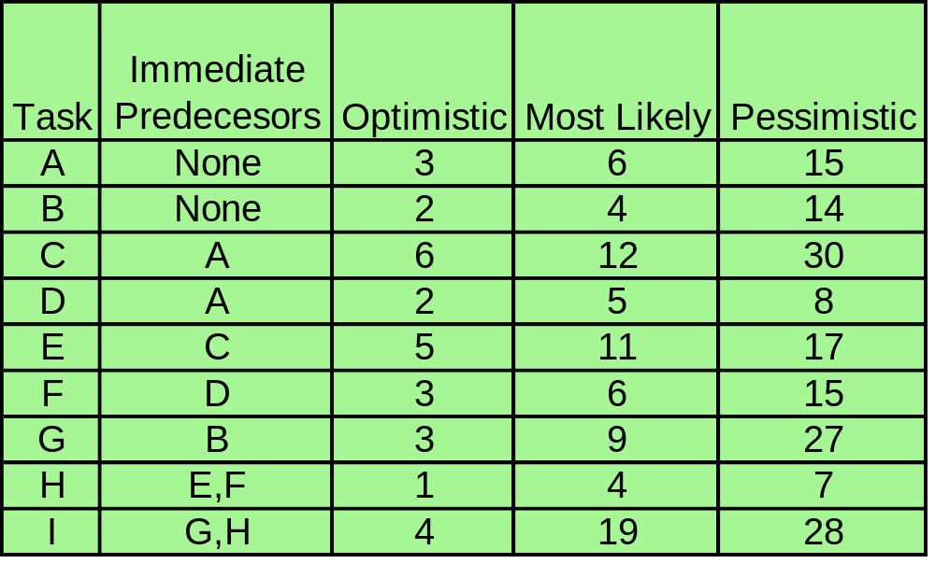
Example 2. CPM with Three Activity Time Estimates

Slide 26
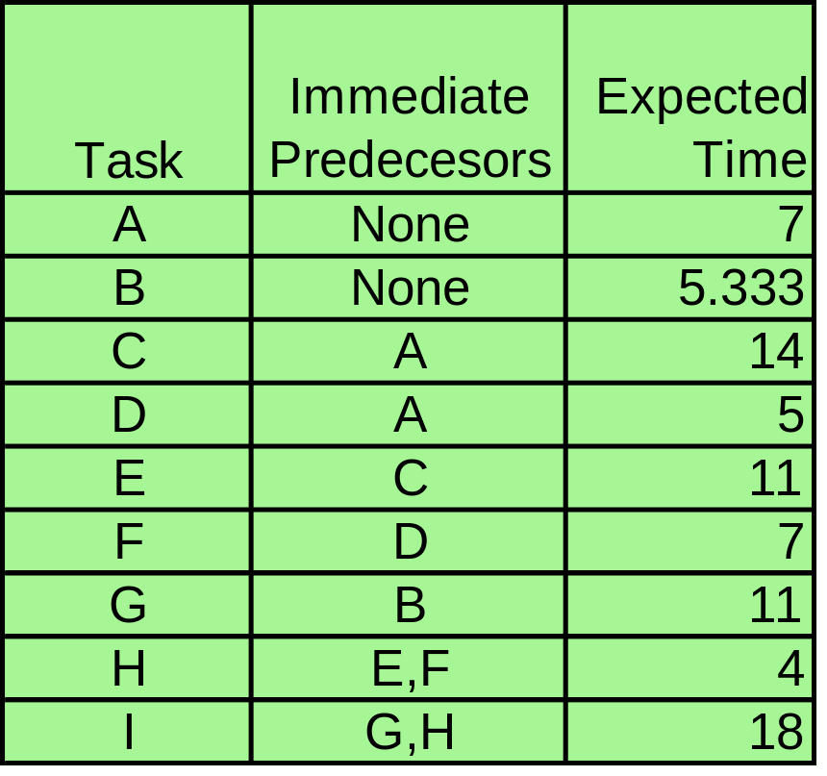
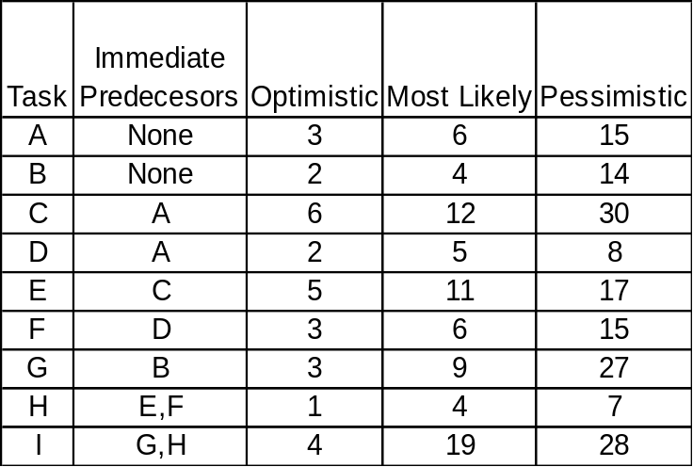
Example 2. Expected Time Calculations
ET(A)= 3+4(6)+15
6
ET(A)=42/6=7

Slide 27
Example 2. Expected Time Calculations
ET(B)= 2+4(4)+14
6
ET(B)=32/6=5.333

Slide 28
Example 2. Expected Time Calculations
ET(C)= 6+4(12)+30
6
ET(C)=84/6=14

Slide 29
Example 2. Network
Duration = 54 Days
C(14)
E(11)
A(7)
H(4)
D(5)
F(7)
I(18)
B
(5.333)
G(11)

Slide 30
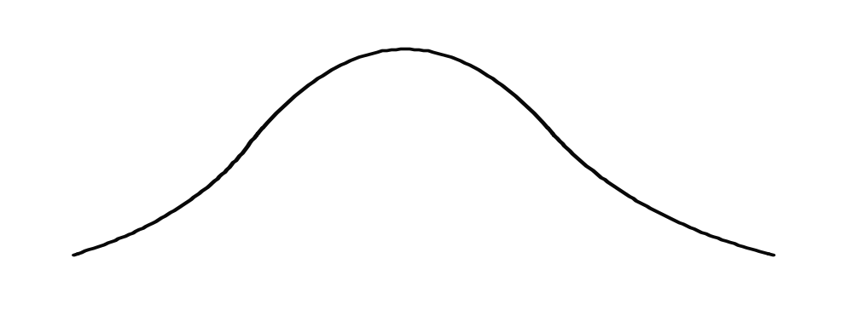
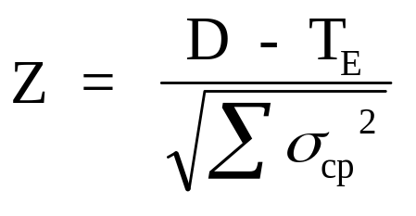
Example 2. Probability Exercise
What is the probability of finishing this project in
less than 53 days?
p(t < D)
D=53
t
T_{E} = 54

Slide 31
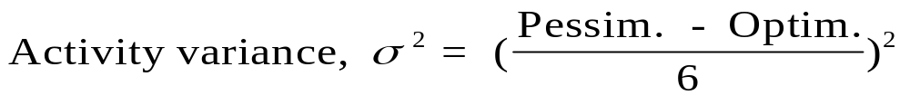
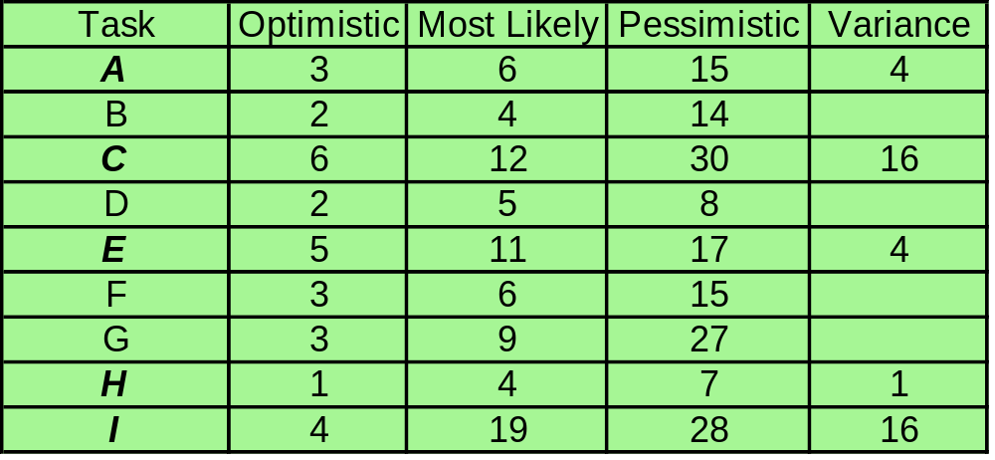
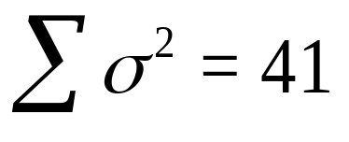
(Sum the variance along the critical path.)

Slide 32
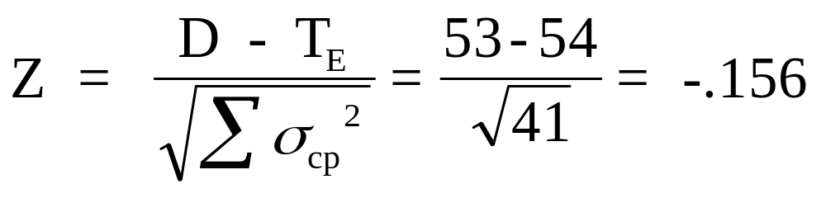
p(t < D)
t
T_{E} = 54
D=53
p(Z < -.156) = .438, or 43.8 % (NORMSDIST(-.156)
There is a 43.8% probability that this project will be completed in less than 53 weeks.

Slide 33
Example 2. Additional Probability Exercise
What is the probability that the project duration will exceed 56 weeks?
Notes:
30

Slide 34
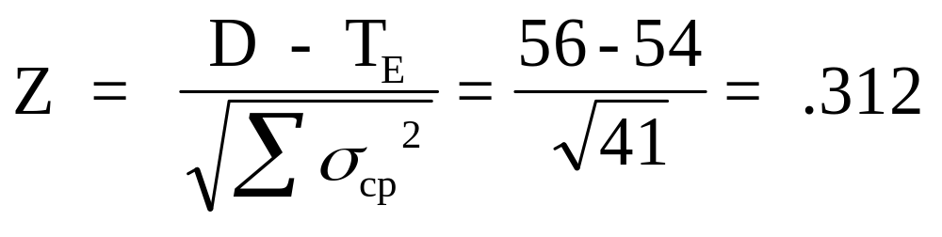
Example 2. Additional Exercise Solution
p(t < D)
t
T_{E} = 54
D=56
p(Z > .312) = .378, or 37.8 % (1-NORMSDIST(.312))
Notes:
31

Slide 35

Time-Cost Models
Basic Assumption: Relationship between activity completion time and project cost
Time Cost Models: Determine the optimum point in time-cost tradeoffs
  Activity direct costs
  Project indirect costs
  Activity completion times
Notes:
32

Slide 36
CPM Assumptions/Limitations
Project activities can be identified as entities (There is a clear beginning and ending point for each activity.)
Project activity sequence relationships can be specified and networked
Project control should focus on the critical path
The activity times follow the beta distribution, with the variance of the project assumed to equal the sum of the variances along the critical path
Project control should focus on the critical path
Notes:
15

Slide 37
End of Chapter 3

